Slide 1


Moniter-X
Automated API Testing & Monitoring Platform
(Capstone Project Semester - 7)
Presented By:
R2142230272 - Nandik Dawar (B2)
R2142230376 - Harsh Kumar Jha (B2)
R2142230585 – Shruti Tripathi (B3)
Full Stack AI
Mentored By:
Dr. Archana Kumari

Slide 2
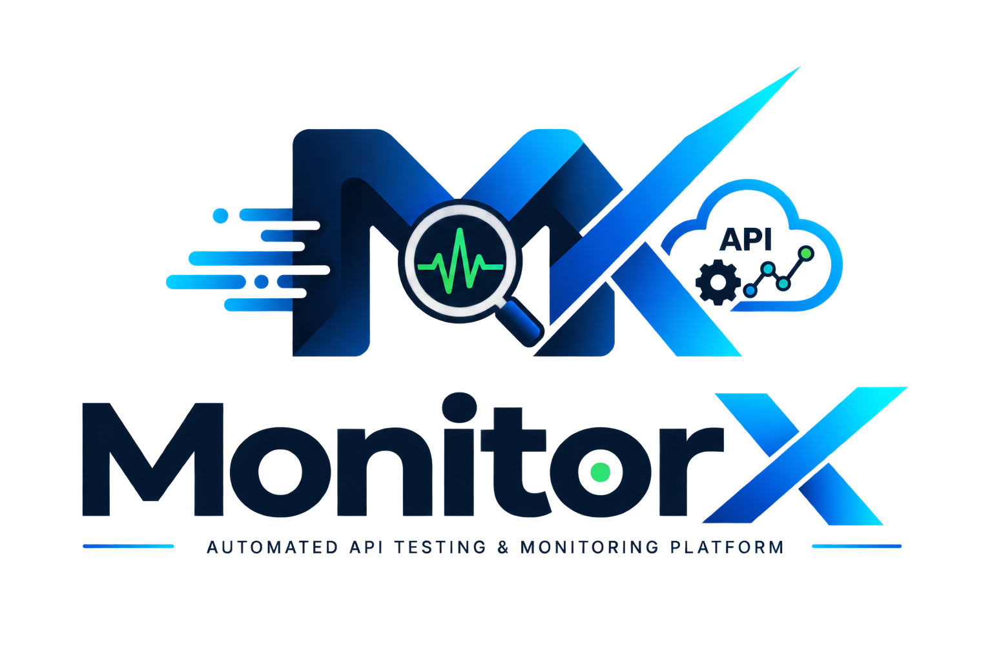
Abstract
Modern software applications depend heavily on APIs for communication between services, making API reliability and performance essential.
Monitor-X is a full-stack automated API testing and monitoring platform designed to:
Execute API tests automatically.
Schedule tests at predefined intervals.
Monitor API availability, response time, and reliability.
Detect failures and performance degradation.
Maintain historical API performance data.
Provide developers with dashboards, logs, and alerts.
The platform aims to reduce manual testing effort while improving visibility into API behaviour and system reliability.

Slide 3
Introduction
APIs are a core component of modern software systems.
They enable communication between:
    Frontend and backend services
    Microservices
    Databases
    Cloud platforms
    External applications
API failures can cause downtime, slow responses, incorrect data exchange, and service disruption.
Traditional API testing is often manual or limited to CI/CD pipelines.
Such approaches provide limited visibility into API behaviour after deployment.
Monitor-X combines automated API testing with continuous monitoring.
It also tracks failures and historical performance to improve API reliability and performance.

Slide 4
Problem Statement
Existing API testing approaches generally focus on validating APIs during development or within CI pipelines.
Major limitations include:
Repeated manual execution of API tests.
Limited continuous monitoring.
Difficulty identifying performance degradation over time.
Delayed detection of API failures.
Lack of centralized historical API performance data.
Limited actionable insights for developers.
Therefore, there is a need for a system capable of automatically testing APIs while continuously monitoring their health, reliability, and performance.
This is directly aligned with the problem identified in your project description.
And this slide is worth having because your synopsis evaluation explicitly gives marks for the Problem itself.

Slide 5
Objective
Primary Objective
To develop a full-stack platform capable of automating API testing and continuously monitoring API health and performance.
Specific Objectives
Automate execution of user-defined API test cases.
Schedule API tests at predefined intervals.
Monitor API availability and uptime.
Measure API response time and performance.
Detect failed API requests automatically.
Maintain detailed failure logs.
Store historical test and performance data.
Provide real-time monitoring dashboards.
Generate alerts when API failures occur.
Reduce dependence on repetitive manual testing.

Slide 6
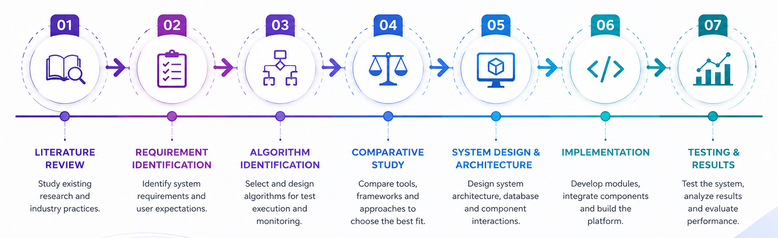
Methodology

Slide 7
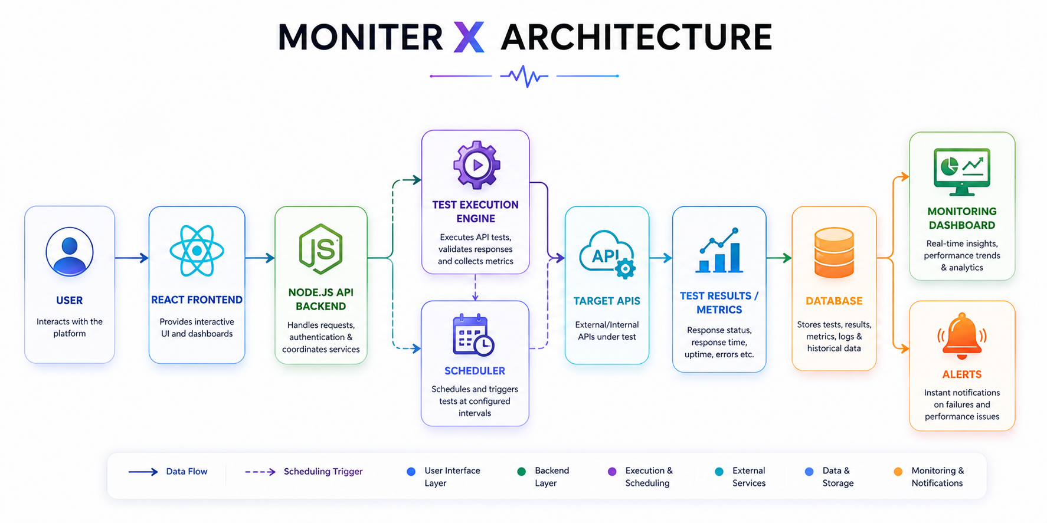

Slide 8
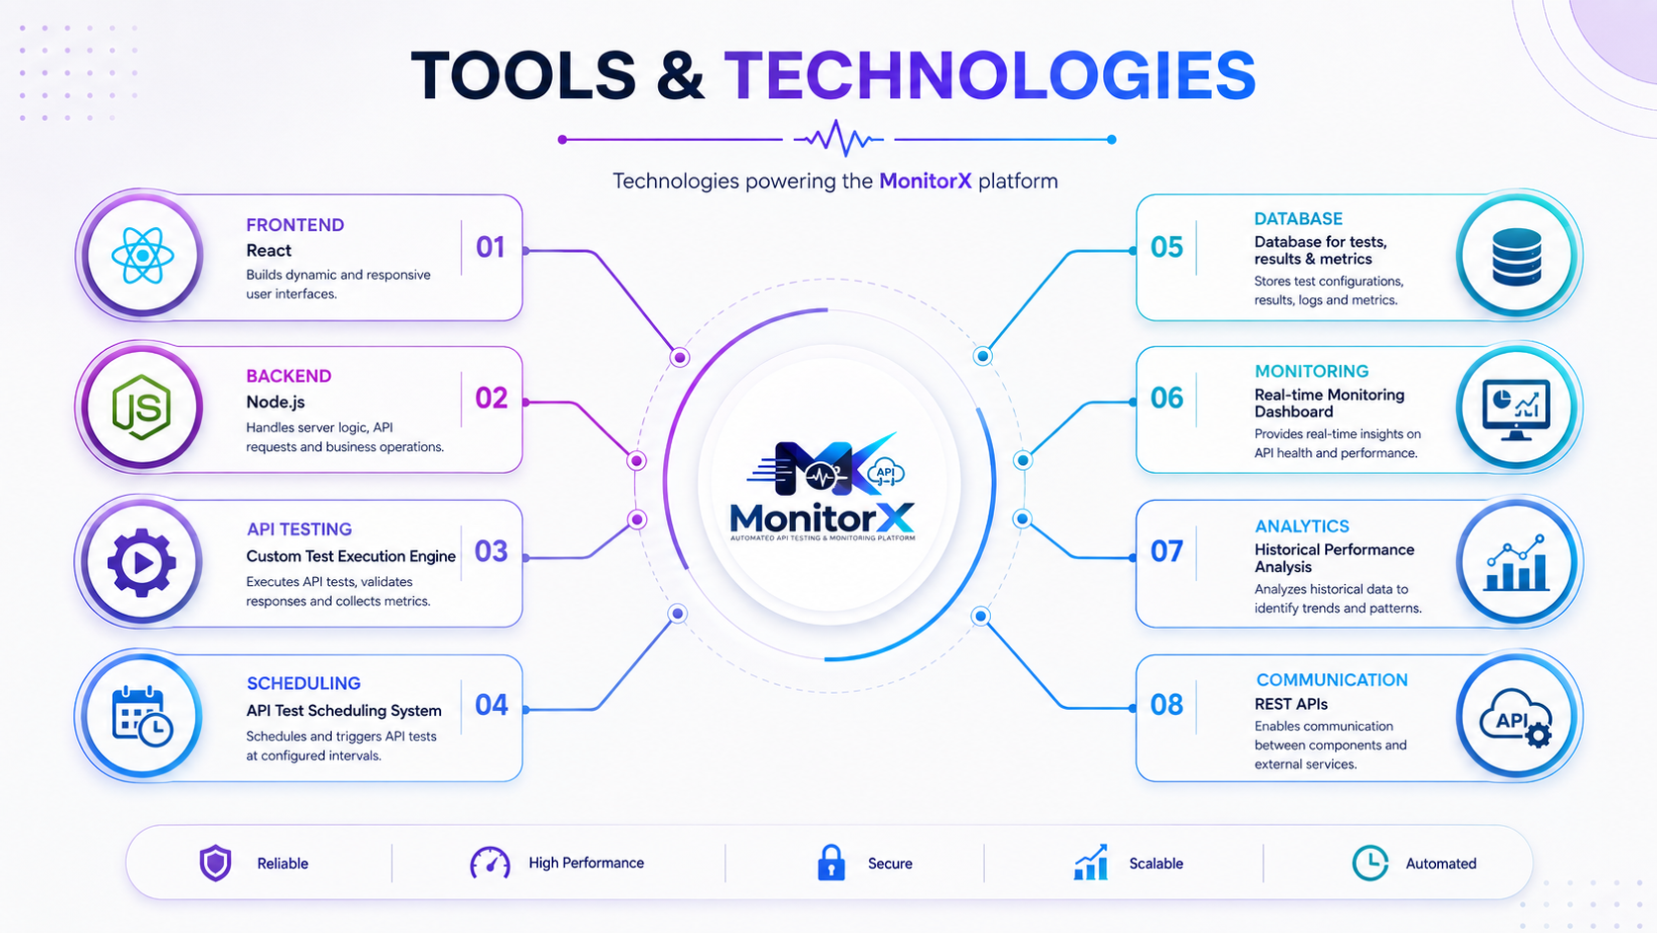

Slide 9
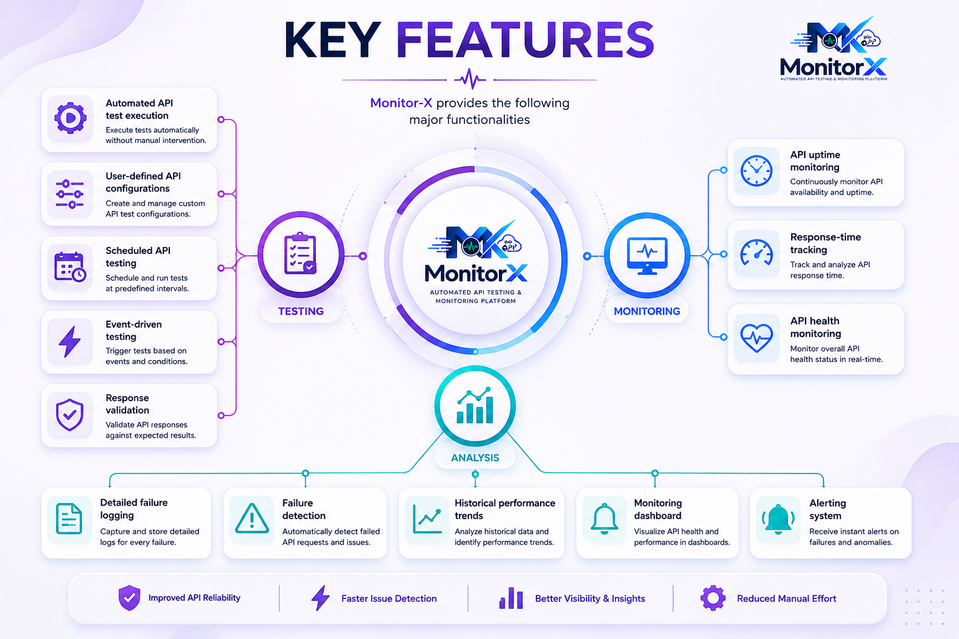

Slide 10
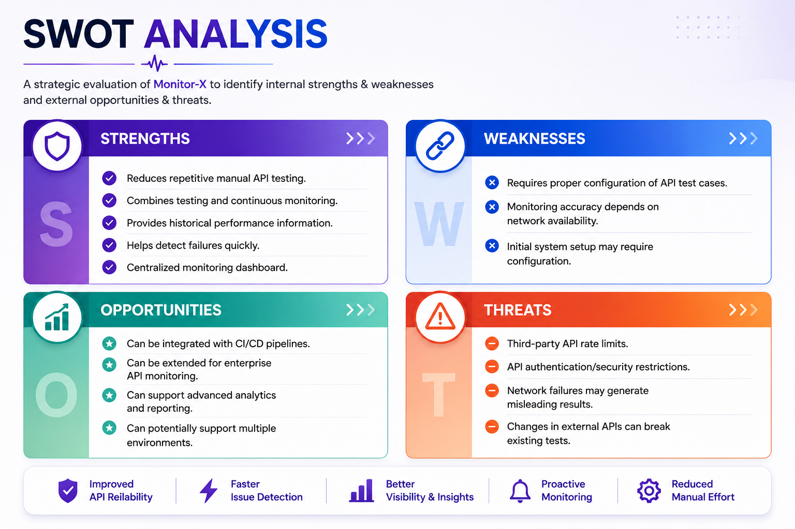

Slide 11
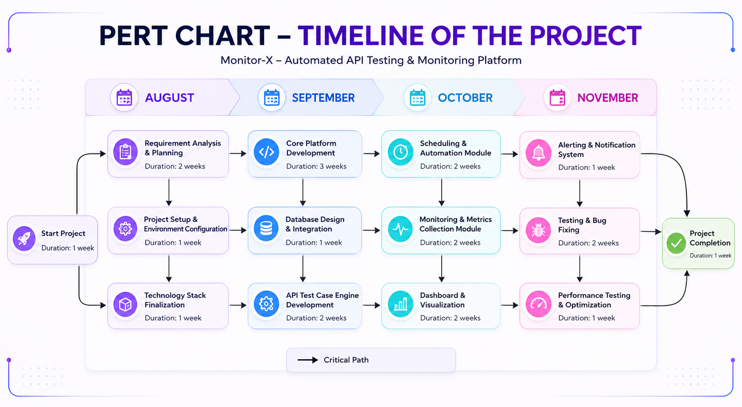

Slide 12
